Slide 1









Safe Storage and Distribution

Slide 2
Receiving of Medicines
Verification
Expiry
Entry
Stock Ledger (as per the provided format)
Update
State Specific IT management software
Batch no.
Labelling
Physical conditions
Activities to be conducted after Receipt of Medicines:

Slide 3
Storage Requirements at AAM
Temperature Specific Storage Requirements
Physical Storage Requirements
Storage of Pediatric Medication
Management of LASA Drugs

Slide 4
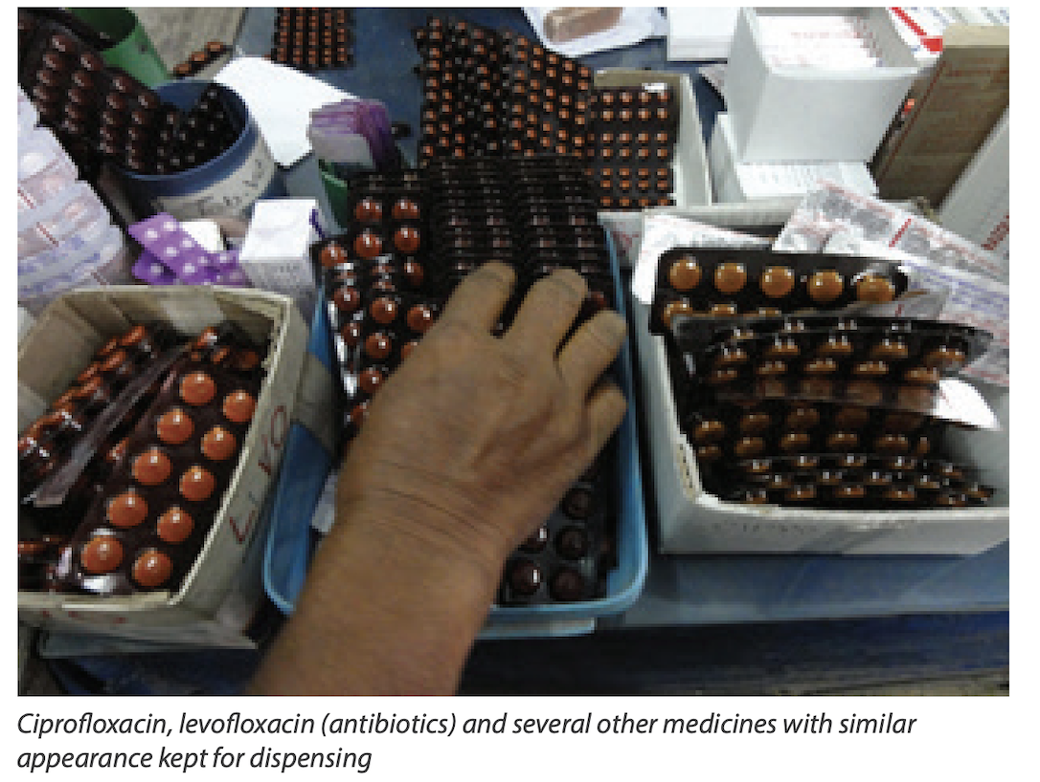
Introduction: Safe Medication Practices and Safe Dispensing
Medication errors are a leading cause of patient harm globally. WHO launched the Global Patient Safety Challenge: Medication Without Harm, with the objective of preventing severe medication related patient harm.
Look-alike, Sound alike errors
Location in the Name | Letters | Example of Medicines
Beginning | AM | Amlodipine, Amiodarone, Amitryptyline
 | AZ | Azathioprine, Azithromycin
Middle | gaba | Pregabalin, Gabapentin
End | azole | Metronidazole, omeprazole

Slide 5
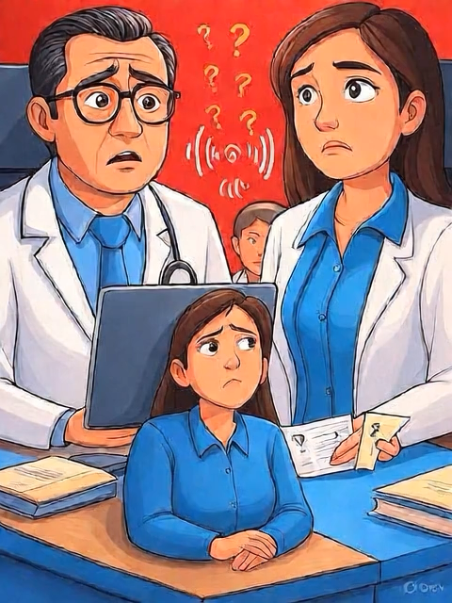
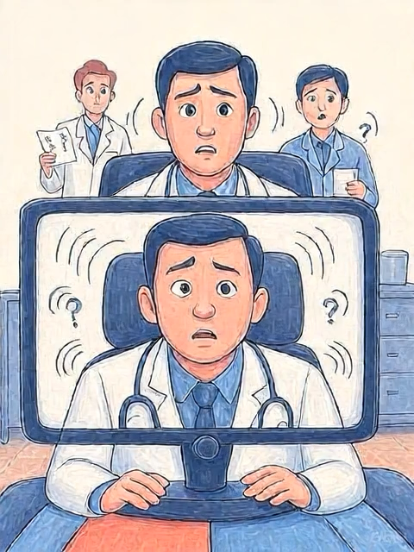


Stages of Medication use at which LASA errors can occur
Prescription:
Transcribing or Documenting:
Distribution errors:
Selection of products according to where they are stored or according to the packaging rather than the name and strength of the product
Storage of LASA medicines on the same shelf next to each other
4. Administering
5. Monitoring
Clinical Impact of LASA errors on Vulnerable Populations:
Vulnerable Populations:
Toxicity
ADR
Extended illness

Slide 6
Stages of Medication use at which LASA errors can occur
Prescribing
Illegible or poorly legible handwritten prescriptions or orders, resulting in wrong interpretation
Verbal and telephone orders for medications
Inappropriate use of error-prone abbreviations; for example, MSO4 can be interpreted as magnesium sulphate or morphine sulphate, resulting in serious errors
Transcribing or Documenting: Incorrect interpretation of sound-alike LASA medicines due to lack of a read-back mechanism during verbal and telephone orders.
Distribution errors
Selection of products according to where they are stored or according to the packaging rather than the name and strength of the product
Storage of LASA medicines on the same shelf next to each other
Administering: Unclear instructions for administration, for example, use of “as directed”, leaving instructions open to misinterpretation
Monitoring: Failure to monitor outcomes of medication by relevant clinical observations or biochemistry
Clinical Impact of LASA errors on Vulnerable Populations:
LASA errors can result in toxicity due to overdosing of a medicine, adverse effects of an unintended medicine, and exacerbation of the disease for which the intended medicine was not given.
Vulnerable Groups:
Chronic Disease Patients
Pediatric Patients
Geriatric Patients

Slide 7
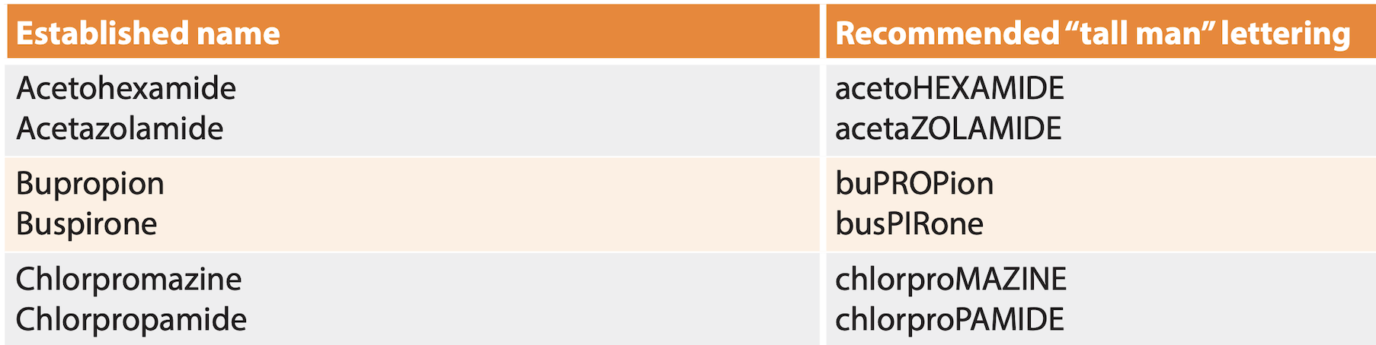
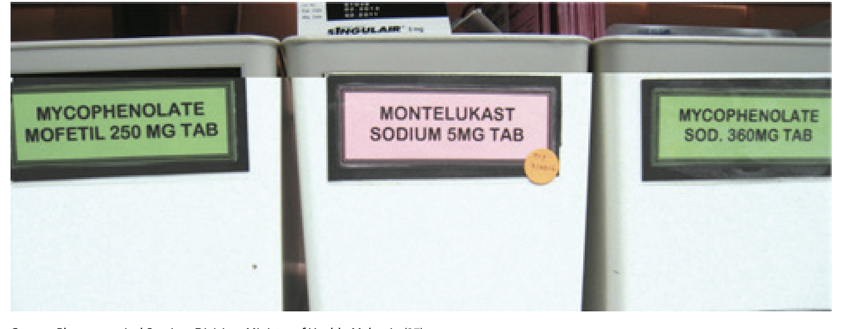
Strategies for Storage and Usage of LASA
Creating and updating list of LASA medicines
Widescale IEC of LASA list and Concept for improving Awareness
Tall man lettering
Clear Labelling, Segregating and Storage as per color coding
Training of Health care workers
Report Medication error incidents to strengthen and improve current system.

Slide 8
Storage and Temperature
Recommended limits for descriptive storage conditions
Sl. No. | Label description | Recommended limits
1 | Store at controlled room temperature/ room temperature | 15 to 25 °C
2 | Store in a cold or cool place | 8 to 15 °C
3 | Store in a refrigerator | 5 ± 3 °C
4 | Store in a freezer/ frozen | –20 ± 5 °C
5 | Store in deep freezer | –70 ± 10 °C
6 | Store in a dry place | No more than 60% relative humidity
7 | Protect from moisture | No more than 60% relative humidity
8 | Store under ambient conditions | Store in well-ventilated premises at temperatures of between 15 °C and 30 °C and no more than 60% relative humidity. Extraneous odours, other indications of contamination and intense light must be excluded.
9 | Protect from light | To be maintained in the original manufacturer’s light-resistant containers.
Source: Recommended storage condition, WHO, https://cdn.who.int/media/docs/default-source/medicines/norms-and standards/guidelines/distribution/trs1025-annex7-(1).pdf?sfvrsn=1f96888d_4&download=true

Slide 9
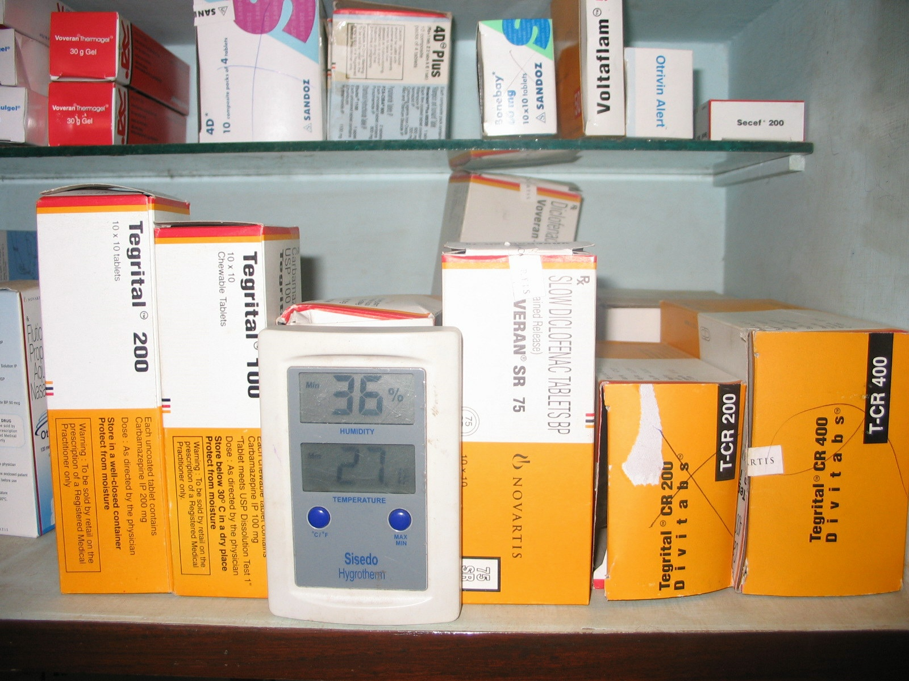
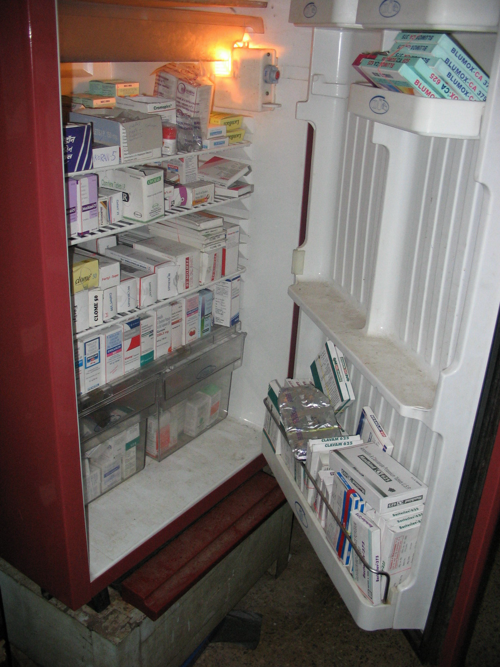
Periodic Checking Of Temperature And Humidity
Cleaning Of Refrigerators And Defrosting

Slide 10
Storage And Dispensing Of Narcotic And Psychotropic Drugs
Drugs must be stored under double lock and key in a secure area accessible only to authorized staff.
Dispensing requires a proper prescription from a Registered Medical Practitioner, and only selected, registered patients may receive these drugs.
Each prescription must contain specific details, and only one narcotic per prescription is allowed; triplicate prescription pads are used as per regulations.
Prescriptions must be legible, current, and not modified; multiple narcotic drugs require separate prescriptions

Slide 11
Narcotic & Psychotropic Medicines
A narcotic drug is typically a substance that induces sleep, reduces pain, or dulls the senses and is often associated with opiates like opium, morphine, and heroin, though legal definitions sometimes include other drugs like cannabis and cocaine as well.
E.g., Opium, Morphine, Heroin, Codeine, Methadone.
A psychotropic drug refers to compounds that alter the mind or behavior, including those that affect perception, consciousness, cognition, or mood, such as LSD, MDMA (Ecstasy), barbiturates, amphetamines, and designer drugs.
E.g., Fluoxetine, Risperidone, Diazepam, Lithium, Adderall, LSD

Slide 12
Expiry/Near Expiry Stock Management
Apply FEFO Principle (First Expiry, First Out)
Always issue medicines with the nearest expiry first, even if a newer batch is available.
Arrange stock physically on shelves accordingly (older expiry in front, newer at the back).
Routine Monitoring
Conduct monthly stock review to identify medicines nearing expiry (within 6 months).
Redistribution of Near-Expiry Drugs
Coordinate with PHC/CHC to redistribute medicines that may not be consumed before expiry.
Ensure transfer at least 3–6 months before expiry.
Segregation of Expired/Near Expiry Stock
Keep expired/near expiry medicines in a separate box, clearly labeled “Expired – Not for Use”
or “Near Expiry Drugs”.
Documentation & Reporting
Maintain an “Expired Stock Register” recording item name, batch no., expiry date, and quantity.
Safe Disposal
Dispose off expired drugs as per guideline prescribed for disposal of drugs

Slide 13
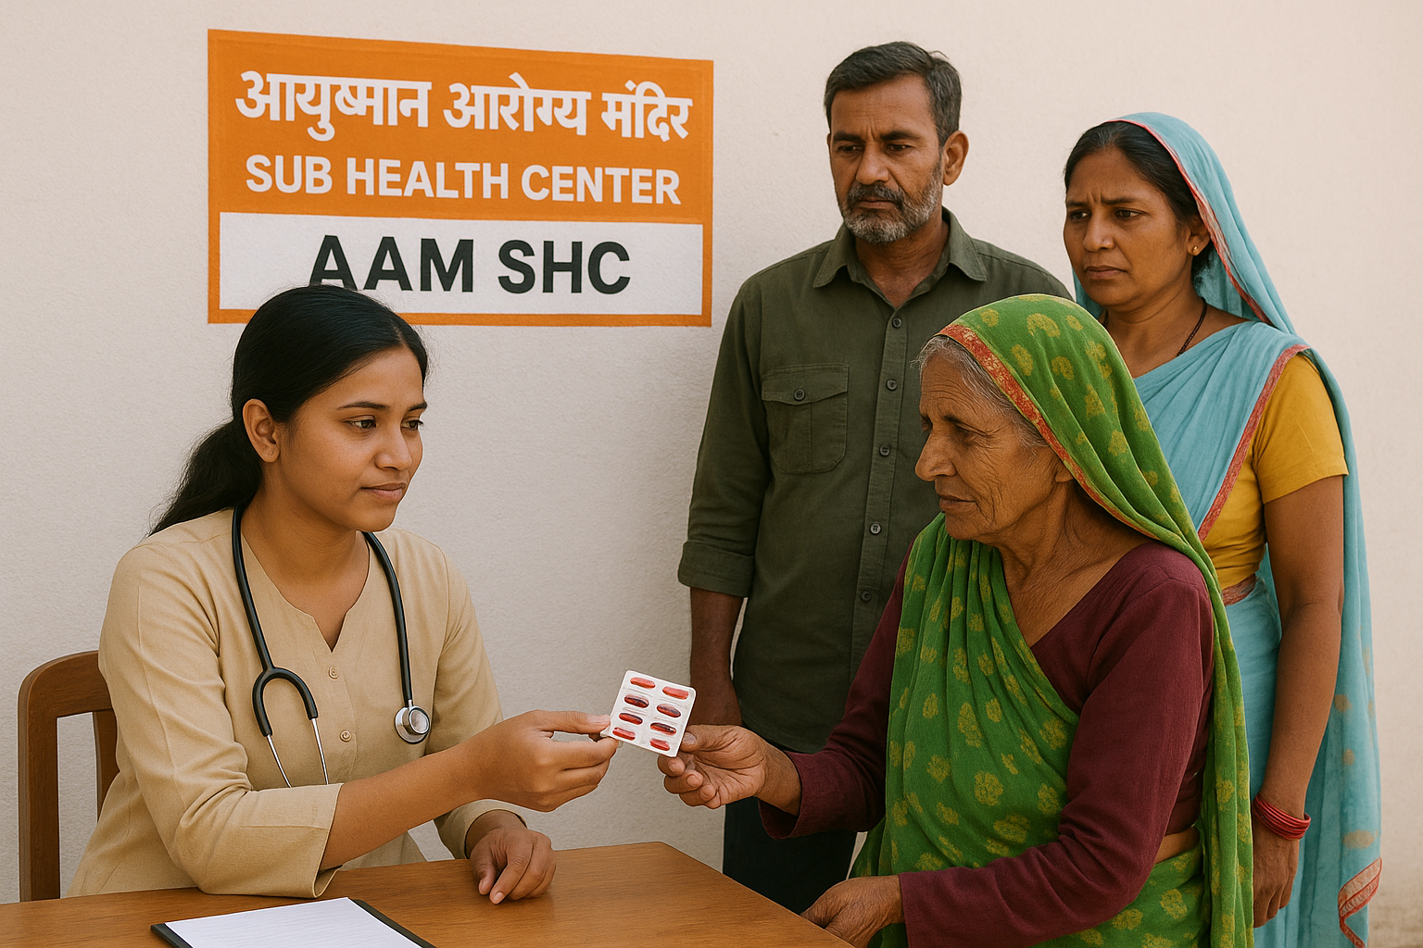
Medicine Distribution
Medicines distribution should be in accordance with operational guidelines and relevant program divisions.

Slide 14
Strip Cutting and Medicine Handling
While cutting the strips consider maintaining the readability of following
Name
Expiry details
Batch No.
While handing the Medicines to the Patients, ensure the following
Hand out medicines in Paper bags
Label the instructions on how to take medicines on the paper bag and mark on strips as well.

Slide 15
Patient Counselling
Patient History and Social History
Explaining the use of each medicines
Explaining how and when to consume each medicine
Counsel and segregate LASA medicines (if applicable)
Brief and Caution about ADRs

Slide 16
Adverse Drug Reaction Identification and Reporting
Unintended, harmful reactions to medicines (known as adverse drug reactions)Adverse Event: Any harmful occurrence during treatment
The majority of adverse drug reactions (ADR) are preventable
Causality: The relationship between the drug and the event
Severity: The intensity of the ADR

Slide 17
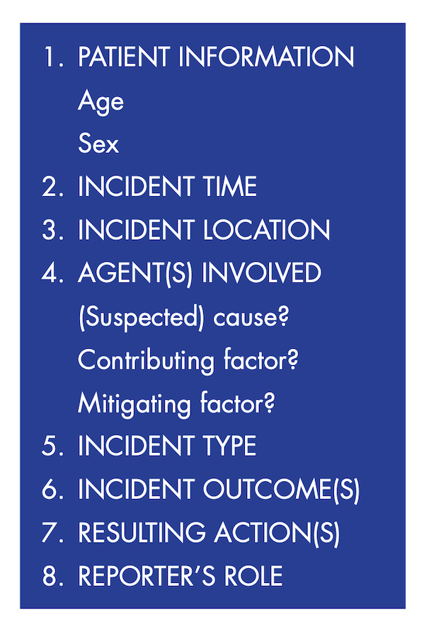
ADR reporting form

